Slide 1
Database Systems
Chapter # 7
More SQL: Complex Queries, Triggers, Views, and Schema Modification

Slide 2
Chapter Outlines
More Complex SQL Retrieval Queries
Views (Virtual Tables) in SQL
Schema Change Statements in SQL

Slide 3
Joined Tables in SQL and Outer Joins
SQL joins are used to combine two or more tables.
The joining of two or more tables is based on common field between them.
Syntax:
select col1,col2,....
from table1 JOIN table2 ON (common columns in both tables)
where condition

Slide 4
Types of Joins
Cartesian Product
Equi JOIN/ Inner Join/ Join
Left outer Join/ Left Join
Right Outer Join/ Right Join
Self Join

Slide 5
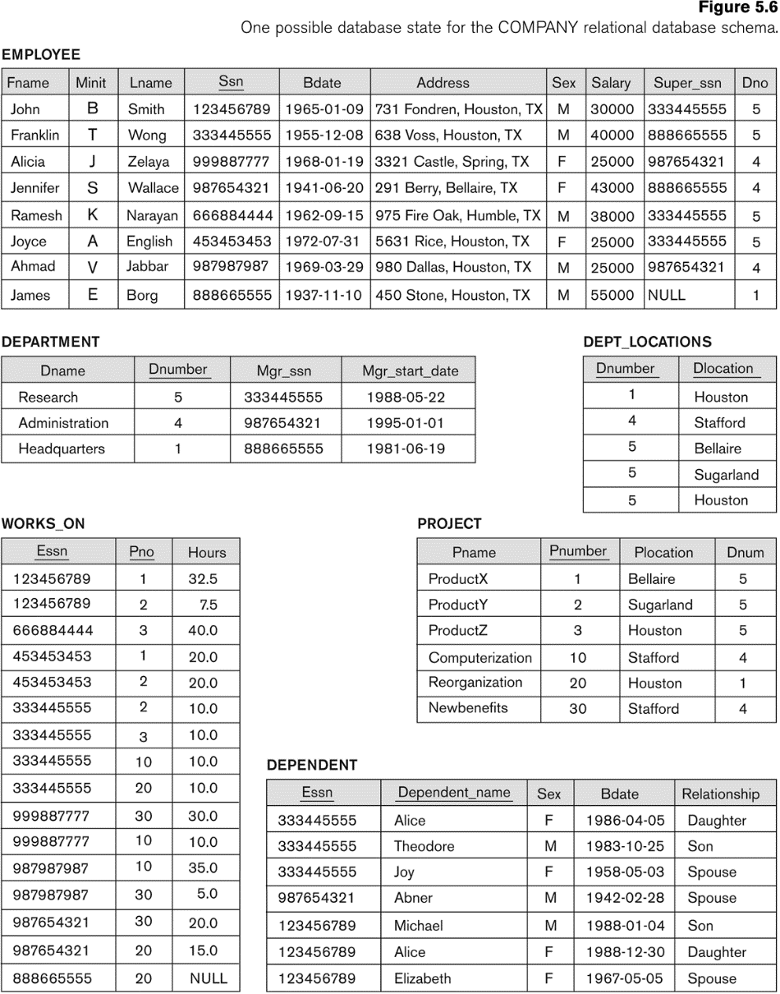
Basic SQL Queries: The SELECT-FROM-WHERE Structure with join
Query 1. Retrieve the name and address of all employees who work for the
‘Research’ department.
Notes:
SELECT Fname, Lname, Address FROM EMPLOYEE, DEPARTMENT WHERE Dname = ‘Research’ AND Dnumber = Dno;
In the WHERE clause of Q1, the condition Dname = ‘Research’ is a selection condition that chooses the particular tuple of interest in the DEPARTMENT table, because Dname is an attribute of DEPARTMENT. The condition Dnumber = Dno is called a join condition, because it combines two tuples: one from DEPARTMENT and one from EMPLOYEE, whenever the value of Dnumber in DEPARTMENT is equal to the value of Dno in EMPLOYEE. The result of query Q1 is shown in Figure 6.3(b). In general, any number of selection and join conditions may be specified in a single SQL query. A query that involves only selection and join conditions plus projection attributes is known as a select-project-join query. The next example is a select-project-join query with two join conditions

Slide 6
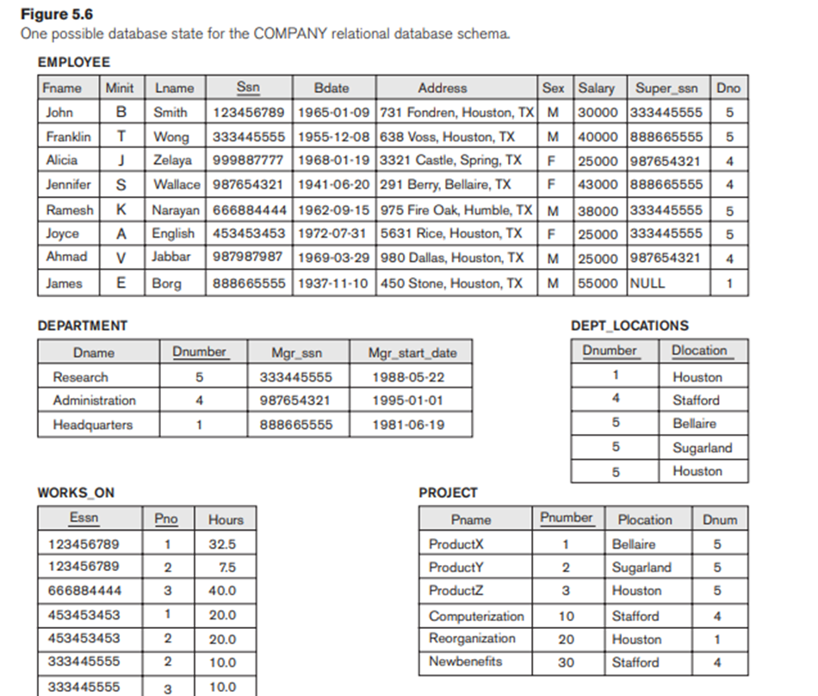
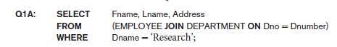
Example
Retrieves the name and address of every employee who works for the ‘Research’ department.
Notes:
The FROM clause in Q1A contains a single joined table.
The attributes of such a table are all the attributes of the first table, EMPLOYEE, followed by all the attributes of the second table, DEPARTMENT.
The concept of a joined table also allows the user to specify different types of join, such as NATURAL JOIN and various types of OUTER JOIN.

Slide 7
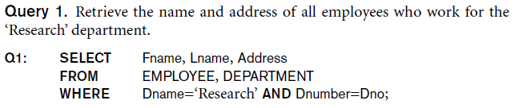
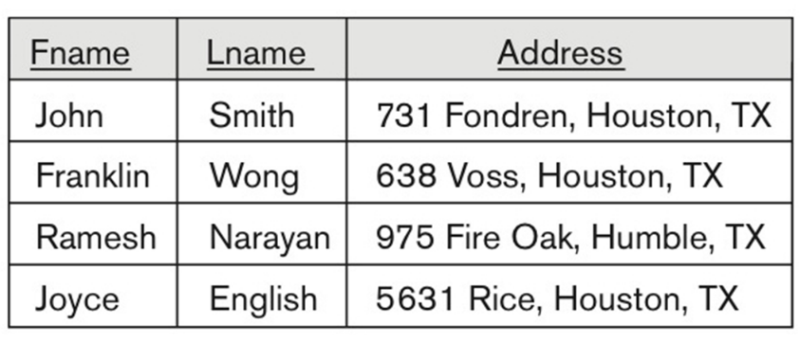
Basic SQL Queries: The SELECT-FROM-WHERE Structure with join
Notes:
SELECT Fname, Lname, Address FROM EMPLOYEE, DEPARTMENT WHERE Dname = ‘Research’ AND Dnumber = Dno;

Slide 8
Basic SQL Queries: The SELECT-FROM-WHERE Structure with join
Query 2. For every project located in ‘Stafford’, list the project number, the
controlling department number, and the department manager’s last name,
address, and birth date.
Notes:
SELECT Pnumber, Dnum, Lname, Address, Bdate FROM PROJECT, DEPARTMENT, EMPLOYEE WHERE Dnum = Dnumber AND Mgr_ssn = Ssn AND Plocation = ‘Stafford’
In the WHERE clause of Q1, the condition Dname = ‘Research’ is a selection condition that chooses the particular tuple of interest in the DEPARTMENT table, because Dname is an attribute of DEPARTMENT. The condition Dnumber = Dno is called a join condition, because it combines two tuples: one from DEPARTMENT and one from EMPLOYEE, whenever the value of Dnumber in DEPARTMENT is equal to the value of Dno in EMPLOYEE. The result of query Q1 is shown in Figure 6.3(b). In general, any number of selection and join conditions may be specified in a single SQL query. A query that involves only selection and join conditions plus projection attributes is known as a select-project-join query. The next example is a select-project-join query with two join conditions

Slide 9
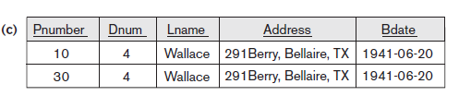
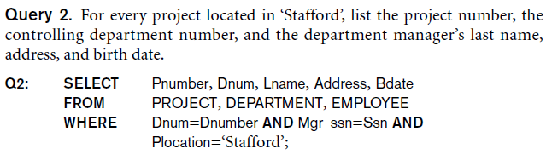
Basic SQL Queries: The SELECT-FROM-WHERE Structure with join
Notes:
SELECT Pnumber, Dnum, Lname, Address, Bdate FROM PROJECT, DEPARTMENT, EMPLOYEE WHERE Dnum = Dnumber AND Mgr_ssn = Ssn AND Plocation = ‘Stafford’

Slide 10
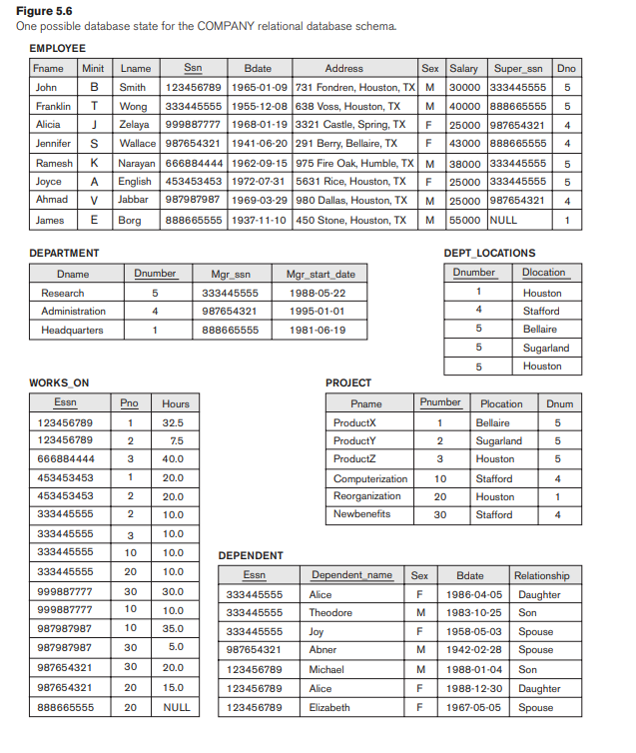
Query 2. For every project located in ‘Stafford’, list the project number, the controlling department number, and the department manager’s last name, address, and birth date
Q2A: SELECT Pnumber, Dnum, Lname, Address, Bdate
FROM ((PROJECT JOIN DEPARTMENT ON Dnum = Dnumber)
JOIN EMPLOYEE ON Mgr_ssn = Ssn)
WHERE Plocation = ‘Stafford’;

Slide 11
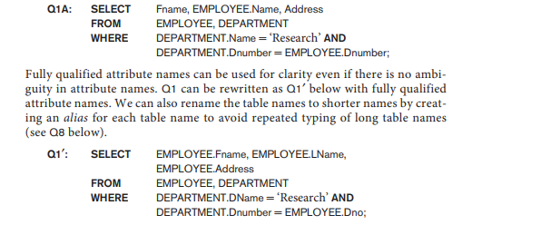
Ambiguous Attribute Names, Aliasing, Renaming, and Tuple Variables
Same name can be used for two (or more) attributes in different relations
As long as the attributes are in different relations
Must qualify the attribute name with the relation's name to prevent ambiguity
Notes:
In SQL, the same name can be used for two (or more) attributes as long as the attributes are in different tables. If this is the case, and a multitable query refers to two or more attributes with the same name, we must qualify the attribute name with the relation name to prevent ambiguity. This is done by prefixing the relation name to the attribute name and separating the two by a period. To illustrate this, suppose that in Figures 5.5 and 5.6 the Dno and Lname attributes of the EMPLOYEE relation were called Dnumber and Name, and the Dname attribute of DEPARTMENT was also called Name; then, to prevent ambiguity, query Q1 would be rephrased as shown in Q1A. We must prefix the attributes Name and Dnumber in Q1A to specify which ones we are referring to, because the same attribute names are used in both relations:

Slide 12
SELF JOIN
Query 3. For each employee, retrieve the employee’s first and last name and the first and last name of his or her immediate supervisor.
Notes:
SELECT E.Fname, E.Lname, S.Fname, S.Lname FROM EMPLOYEE AS E, EMPLOYEE AS S WHERE E.Super_ssn = S.Ssn;

Slide 13
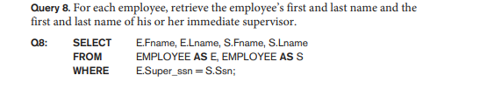
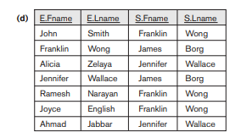
SELECT E.Fname, E.Lname, S.Fname, S.Lname FROM EMPLOYEE E, EMPLOYEE S WHERE E.Super_ssn = S.Ssn;
Notes:
SELECT E.Fname, E.Lname, S.Fname, S.Lname FROM EMPLOYEE AS E, EMPLOYEE AS S WHERE E.Super_ssn = S.Ssn;

Slide 14
NATURAL JOIN
In a NATURAL JOIN on two relations R and S, no join condition is specified;
An implicit EQUIJOIN condition for each pair of attributes with the same name from R and S is created.
Each such pair of attributes is included only once in the resulting relation.
Q1B: SELECT Fname, Lname, Address, D.Dnumber AS Dno
FROM (EMPLOYEE E NATURAL JOIN DEPARTMENT D
WHERE Dname = ‘Research’;
Implicit join condition: EMPLOYEE.Dno = DEPT.Dno
Notes:
In a NATURAL JOIN on two relations R and S, no join condition is specified; an implicit EQUIJOIN condition for each pair of attributes with the same name from R and S is created. Each such pair of attributes is included only once in the resulting
Relation.
Very Important
If the names of the join attributes are not the same in the base relations, it is possible to rename the attributes so that they match, and then to apply NATURAL JOIN. In this case, the AS construct can be used to rename a relation and all its attributes in the FROM clause.
This is illustrated in Q1B, where the DEPARTMENT relation is renamed as DEPT and its attributes are renamed as Dname, Dno (to match the name of the desired join attribute Dno in the EMPLOYEE table), Mssn, and Msdate. The implied join condition for this NATURAL JOIN is EMPLOYEE.Dno = DEPT.Dno, because this is the only pair of attributes with the same name after renaming:

Slide 15
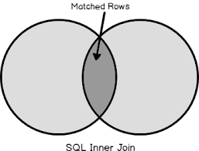
Inner join/Join
Default type of join in a joined table
Tuple is included in the result only if a matching tuple exists in the other relation.
Notes:
In SQL, the options available for specifying joined tables include INNER JOIN (only pairs of tuples that match the join condition are retrieved, same as JOIN)
LEFT OUTER JOIN (every tuple in the left table must appear in the result; if it does not have a matching tuple, it is padded with NULL values for the attributes of the right table),
RIGHT OUTER JOIN (every tuple in the right table must appear in the result; if it does not have a matching tuple, it is padded with NULL values for the attributes of the left table), and
FULL OUTER JOIN.
In the latter three options, the keyword OUTER may be omitted.
If the join attributes have the same name, one can also specify the natural join variation of outer joins by using the keyword NATURAL before the operation (for example, NATURAL LEFT OUTER JOIN). The keyword CROSS JOIN is used to specify
the CARTESIAN PRODUCT operation, although this should be used only with the utmost care because it generates all possible tuple combinations.
It is also possible to nest join specifications; that is, one of the tables in a join may itself be a joined table. This allows the specification of the join of three or more tables as a single joined table, which is called a multiway join. For example,
Q2A is a different way of specifying query Q2 from Section 6.3.1 using the concept of a joined table:
Q2A: SELECT Pnumber, Dnum, Lname, Address, Bdate
FROM ((PROJECT JOIN DEPARTMENT ON Dnum = Dnumber)
JOIN EMPLOYEE ON Mgr_ssn = Ssn)
WHERE Plocation = ‘Stafford’;

Slide 16
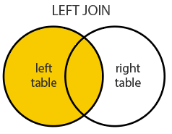
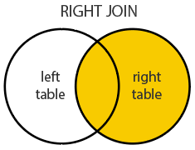
Outer JOIN
LEFT OUTER JOIN
Every tuple in left table must appear in result
No matching tuple: attributes of right table are Padded with NULL values
RIGHT OUTER JOIN
Every tuple in right table must appear in result
No matching tuple: attributes of left table are Padded with NULL values

Slide 17
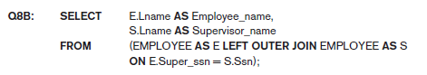
Query 8. For each employee, retrieve the employee’s first and last name and the first and last name of his or her immediate supervisor.

Slide 18
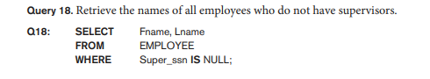
Comparison Operator: IS or IS NOT
IS or IS NOT: check whether an attribute value is NULL or NOT NULL

Slide 19
Nested Queries/ Subqueries
Subqueries:
can be placed in a number of SQL clauses like
WHERE clause
FROM clause
HAVING clause.
can be used with SELECT, UPDATE, INSERT, DELETE statements along with the operators like =, <, >, >=, <=, IN, BETWEEN, etc.
A subquery is a query within another query. The outer query is known as the main query, and the inner query is known as a subquery.
Subqueries are on the right side of the comparison operator and enclosed in parentheses.
Note: In the Subquery, ORDER BY command cannot be used. But GROUP BY command can be used to perform the same function as ORDER BY command.

Slide 20
Sub Queries: Syntax
Format:
SELECT column_name
FROM table_name
WHERE column_name expression operator
( SELECT column_name from table_name WHERE ... );
Query:
SELECT ProductName
FROM Products
WHERE SupplierID IN (SELECT SupplierID FROM Suppliers WHERE Country = 'USA');
Notes:
Some queries require that existing values in the database be fetched and then used in a comparison condition. Such queries can be conveniently formulated by using nested queries, which are complete select-from-where blocks within another SQL query. That other query is called the outer query. These nested queries can also appear in the WHERE clause or the FROM clause or the SELECT clause or other SQL clauses as needed.
Query 4 is formulated in Q4 without a nested query, but it
can be rephrased to use nested queries as shown in Q4A. Q4A introduces the comparison
operator IN, which compares a value v with a set (or multiset) of values V
and evaluates to TRUE if v is one of the elements in V.

Slide 21

ORDER BY
Query 15. Retrieve a list of employees and the projects they are working on,
ordered by department name and, within each department, ordered alphabetically by
last name, then first name.
SELECT D.Dname, E.Lname, E.Fname, P.Pname
FROM DEPARTMENT D, EMPLOYEE E, WORKS_ON W, PROJECT P
WHERE D.Dnumber = E.Dno AND E.Ssn = W.Essn AND W.Pno = P.Pnumber
ORDER BY D.Dname, E.Lname, E.Fname;
ORDER BY D.Dname DESC, E.Lname ASC, E.Fname ASC
Notes:
Q15: SELECT D.Dname, E.Lname, E.Fname, P.Pname
FROM DEPARTMENT D, EMPLOYEE E, WORKS_ON W,
PROJECT P
WHERE D.Dnumber = E.Dno AND E.Ssn = W.Essn AND W.Pno = P.Pnumber
ORDER BY D.Dname, E.Lname, E.Fname;

Slide 22
Display NAME, LOCATION, PHONE_NUMBER of the students whose section is A.
Students Relation
Section Relation
NAME | ROLL_NO | LOCATION | PHONE_NUMBER
Ram | 101 | Chennai | 9988775566
Raj | 102 | Coimbatore | 8877665544
Sasi | 103 | Madurai | 7766553344
Ravi | 104 | Salem | 8989898989
Sumathi | 105 | Kanchipuram | 8989856868
NAME | ROLL_NO | SECTION
Ravi | 104 | A
Sumathi | 105 | B
Raj | 102 | A
Notes:
Select NAME, LOCATION, PHONE_NUMBER from Students
WHERE ROLL_NO IN
(SELECT ROLL_NO from SECTION where SECTION=’A’);

Slide 23
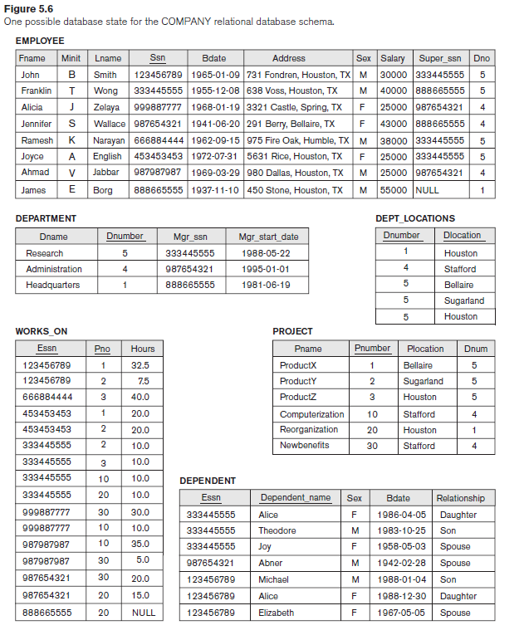
Retrieve the name of each employee who has a dependent with the same first name and is the same sex as the employee.
Notes:
SELECT E.Fname, E.Lname
FROM EMPLOYEE AS E
WHERE E.Ssn IN ( SELECT D.Essn
FROM DEPENDENT AS D
WHERE E.Fname = D.Dependent_name
AND E.Sex = D.Sex );
Another way of writing same query
Q16A: SELECT E.Fname, E.Lname
FROM EMPLOYEE AS E, DEPENDENT AS D
WHERE E.Ssn = D.Essn AND E.Sex = D.Sex
AND E.Fname = D.Dependent_name;

Slide 24
Select the Essns of all employees who work for the same (project, hours) combination on some project that employee ‘John Smith’ (whose Ssn = ‘123456789’)
Notes:
SELECT DISTINCT Essn FROM WORKS_ON WHERE (Pno, Hours) IN ( SELECT Pno, Hours FROM WORKS_ON WHERE Essn = ‘123456789’ );

Slide 25
Write a query that returns the names of employees whose salary is greater than the salary of all the employees in department 5
Notes:
SELECT Lname, Fname
FROM EMPLOYEE
WHERE Salary > ALL ( SELECT Salary
FROM EMPLOYEE
WHERE Dno = 5 );

Slide 26
Type of Subqueries
Single row subquery : Returns zero or one row. Uses Aggregate functions (max, min, avg, count,sum)
Multiple row subquery : Returns one or more rows.
Multiple column subqueries : Returns one or more columns.
Correlated subqueries : Reference one or more columns in the outer SQL statement. The subquery is known as a correlated subquery because the subquery is related to the outer SQL statement.

Slide 27
Equal to and In
If a nested query returns a single attribute and a single tuple: use = instead of IN for the comparison operator.
In general, the nested query will return a table (relation), which is a set or multiset of tuples.

Slide 28
ALL
ALL: used to compare a value to a list or subquery. It must be preceded by =, !=, >, <, <=, >= and followed by a list or subquery.
"x = ALL (...)": The value must match all the values in the list to evaluate to TRUE.
"x != ALL (...)": The value must not match any values in the list to evaluate to TRUE.
"x > ALL (...)": The value must be greater than the biggest value in the list to evaluate to TRUE.
"x < ALL (...)": The value must be smaller than the smallest value in the list to evaluate to TRUE.
"x >= ALL (...)": The value must be greater than or equal to the biggest value in the list to evaluate to TRUE.
"x <= ALL (...)": The value must be smaller than or equal to the smallest value in the list to evaluate to TRUE.

Slide 29
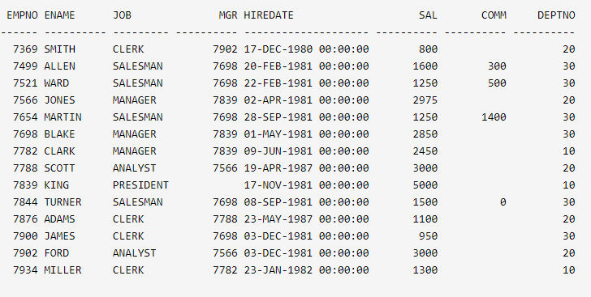
SELECT empno, sal FROM emp WHERE sal > ALL (2000, 3000, 4000); EMPNO
Output : 7839 5000
SQL> -- Transformed to equivalent statement without ALL. SELECT empno, sal FROM emp WHERE sal > 2000 AND sal > 3000 AND sal > 4000;
Output: 7839 5000

Slide 30
SELECT e1.empno, e1.sal
FROM emp e1
WHERE e1.sal > ALL
(SELECT e2.sal
FROM emp e2
WHERE e2.deptno = 20);
EMPNO SAL
---------- ----------
7839 5000

Slide 31
ANY
The ANY comparison condition is used to compare a value to a list or subquery. It must be preceded by =, !=, >, <, <=, >= and followed by a list or subquery.
"x = ANY (...)": The value must match one or more values in the list to evaluate to TRUE.
"x != ANY (...)": The value must not match one or more values in the list to evaluate to TRUE.
"x > ANY (...)": The value must be greater than the smallest value in the list to evaluate to TRUE.
"x < ANY (...)": The value must be smaller than the biggest value in the list to evaluate to TRUE.
"x >= ANY (...)": The value must be greater than or equal to the smallest value in the list to evaluate to TRUE.
"x <= ANY (...)": The value must be smaller than or equal to the biggest value in the list to evaluate to TRUE.

Slide 32
SELECT empno, sal
FROM emp
WHERE
sal > ANY (2000, 3000, 4000);
EMPNO SAL
7566 2975
7698 2850
7782 2450
7788 3000
7839 5000
7902 3000

Slide 33
SELECT e1.empno, e1.sal
FROM emp e1
WHERE e1.sal > ANY (SELECT e2.sal
FROM emp e2
WHERE e2.deptno = 10);
EMPNO SAL
---------- ----------
7839 5000
7902 3000
7788 3000
7566 2975
7698 2850
7782 2450
7499 1600
7844 1500

Slide 34
SELECT empno, sal
FROM emp
WHERE sal > 2000 OR sal > 3000 OR sal > 4000;
EMPNO SAL
---------- ----------
7566 2975
7698 2850
7782 2450
7788 3000
7839 5000
7902 3000

Slide 35
Correlated Nested Queries
Whenever a condition in the WHERE clause of a nested query references some attribute of a relation declared in the outer query, the two queries are said to be correlated.
Evaluated as a top-down approach

Slide 36
Exists and Not Exists
The EXISTS function: used to check whether the result of a nested query is empty (contains no tuples) or not.
The result of EXISTS is a Boolean value TRUE if the nested query result contains at least one tuple, or FALSE if the nested query result contains no tuples.

Slide 37
Retrieve the name of each employee who has a dependent with the same first name and is the same sex as the employee.
Notes:
SELECT E.Fname, E.Lname FROM EMPLOYEE E WHERE EXISTS
( SELECT * FROM DEPENDENT D WHERE E.Ssn = D.Essn AND E.Sex = D.Sex AND E.Fname = D.Dependent_name);

Slide 38
Retrieve the names of employees who have no dependents.
SELECT Fname, Lname FROM EMPLOYEE WHERE NOT EXISTS ( SELECT * FROM DEPENDENT D WHERE E.Ssn = D.Essn );

Slide 39
Aggregate Functions
Used to summarize information from multiple tuples into a single-tuple summary
Grouping is used to create subgroups of tuples before summarization
Built-in aggregate functions: COUNT, SUM, MAX, MIN, COUNT and AVG.
These functions can be used in the SELECT clause or in a HAVING clause.
Notes:
Aggregate functions are used to summarize information from multiple tuples into a single-tuple summary.
Grouping is used to create subgroups of tuples before summarization. Grouping and aggregation are required in many database applications.
A number of built-in aggregate functions exist: COUNT, SUM, MAX, MIN, and AVG.
The COUNT function returns the number of tuples or values as specified in a query.
The functions SUM, MAX, MIN, and AVG can be applied to a set or multiset of numeric values and return, respectively, the sum, maximum value, minimum value, and average (mean) of those values.
These functions can be used in the SELECT clause or in a HAVING clause. The functions MAX and MIN can also be used with attributes that have nonnumeric domains if the domain values have a total ordering among one

Slide 40
Aggregate Functions: Example
Query 19. Find the sum of the salaries of all employees, the maximum salary, the minimum salary, and the average salary.
SELECT SUM (Salary), MAX (Salary), MIN (Salary), AVG (Salary) FROM EMPLOYEE;
Notes:
This query returns a single-row summary of all the rows in the EMPLOYEE table. We could use AS to rename the column names in the resulting single-row table; for example, as in Q19A.
Q19A: SELECT SUM (Salary) AS Total_Sal, MAX (Salary) AS Highest_Sal,
MIN (Salary) AS Lowest_Sal, AVG (Salary) AS Average_Sal
FROM EMPLOYEE;

Slide 41
Query 20. Find the sum of the salaries of all employees of the ‘Research’ department, as well as the maximum salary, the minimum salary, and the average salary in this department.
Q20: SELECT SUM (Salary), MAX (Salary), MIN (Salary), AVG (Salary) FROM (EMPLOYEE JOIN DEPARTMENT ON Dno = Dnumber) WHERE Dname = ‘Research’;
Notes:
Q20: SELECT SUM (Salary), MAX (Salary), MIN (Salary), AVG (Salary) FROM (EMPLOYEE JOIN DEPARTMENT ON Dno = Dnumber)
WHERE Dname = ‘Research’;

Slide 42
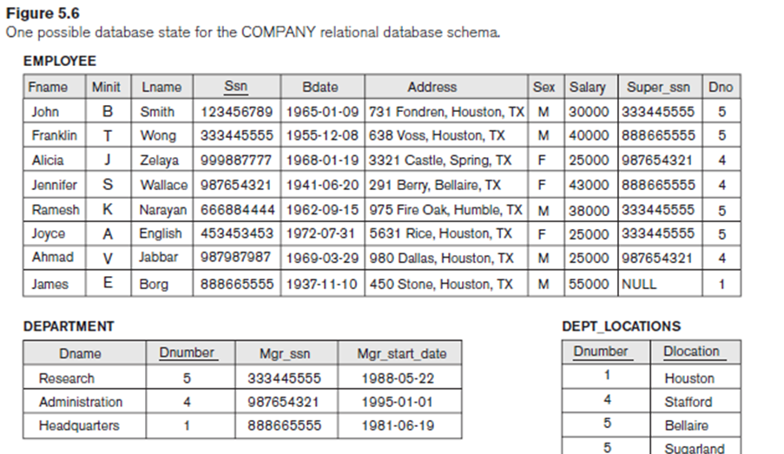
Queries 21 and 22. Retrieve the total number of employees in the company (Q21) and the number of employees in the ‘Research’ department (Q22).
Q21: SELECT COUNT (*) FROM EMPLOYEE
Q22: SELECT COUNT (*)
FROM EMPLOYEE, DEPARTMENT
WHERE DNO = DNUMBER AND DNAME = ‘Research’;
Notes:
Here the asterisk (*) refers to the rows (tuples), so COUNT (*) returns the number of rows in the result of the query.
We may also use the COUNT function to count values in a column rather than tuples

Slide 43
Counting Number of Distinct Salary
Query 23. Count the number of distinct salary values in the database.
Q23: SELECT COUNT (DISTINCT Salary)
FROM EMPLOYEE;
Notes:
If we write COUNT(SALARY) instead of COUNT(DISTINCT SALARY) in Q23, then duplicate values will not be eliminated. However, any tuples with NULL for SALARY will not be counted.
In general, NULL values are discarded when aggregate functions are applied to a particular column (attribute); the only exception is for COUNT(*) because tuples instead of values are counted.
In the previous examples, any Salary values that are NULL are not included in the aggregate function calculation.
The general rule is as follows: when an aggregate function is applied to a collection of values, NULLs are removed from the collection before the calculation;
If the collection becomes empty because all values are NULL, the aggregate function will return NULL (except in the case of COUNT, where it will return 0 for an empty collection of values).
The preceding examples summarize a whole relation (Q19, Q21, Q23) or a selected subset of tuples (Q20, Q22), and hence all produce a table with a single row or a
single value. They illustrate how functions are applied to retrieve a summary value or summary tuple from a table. These functions can also be used in selection conditions
involving nested queries.
We can specify a correlated nested query with an aggregate function, and then use the nested query in the WHERE clause of an outer query.

Slide 44
Q5: Retrieve the names of all employees who have two or more dependents
SELECT Lname, Fname
FROM EMPLOYEE
WHERE ( SELECT COUNT (*)
FROM DEPENDENT
WHERE Ssn = Essn ) > = 2;
Notes:
SELECT Lname, Fname
FROM EMPLOYEE
WHERE ( SELECT COUNT (*)
FROM DEPENDENT
WHERE Ssn = Essn ) > = 2;
The correlated nested query counts the number of dependents that each employee
has; if this is greater than or equal to two, the employee tuple is selected.

Slide 45
Grouping: The GROUP BY and HAVING Clauses
GROUP BY: specifies the grouping attributes
For example, find the average salary of employees in each department or the number of employees who work on each project.
Grouping attributes must appear in the SELECT clause, so that the value resulting from applying each aggregate function to a group of tuples appears along with the value of the grouping attribute(s).
Notes:
In many cases we want to apply the aggregate functions to subgroups of tuples in a relation, where the subgroups are based on some attribute values. For example, we may want to find the average salary of employees in each department or the number of employees who work on each project. In these cases we need to partition the relation into non-overlapping subsets (or groups) of tuples. Each group (partition) will consist of the tuples that have the same value of some attribute(s), called the grouping attribute(s).
We can then apply the function to each such group independently to produce summary information about each group. SQL has a GROUP BY clause for this purpose. The GROUP BY clause specifies the grouping attributes, which should also appear in the SELECT clause, so that the value resulting from applying each aggregate function to a group of tuples appears along with the value of the grouping attribute(s).

Slide 46
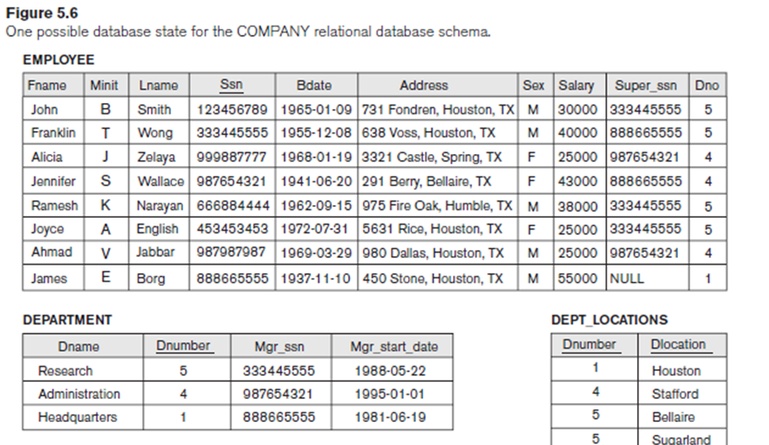
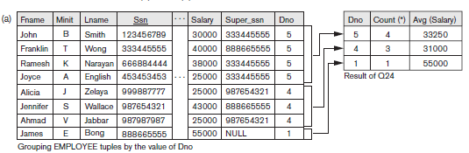
Query 24. For each department, retrieve the department number, the number of employees in the department, and their average salary.
Q24: SELECT Dno, COUNT (*), AVG (Salary)
FROM EMPLOYEE
GROUP BY Dno;
Notes:
If the grouping attribute has NULL as a possible value, then a separate group is created for the null value (e.g., null Dno in the above query)

Slide 47
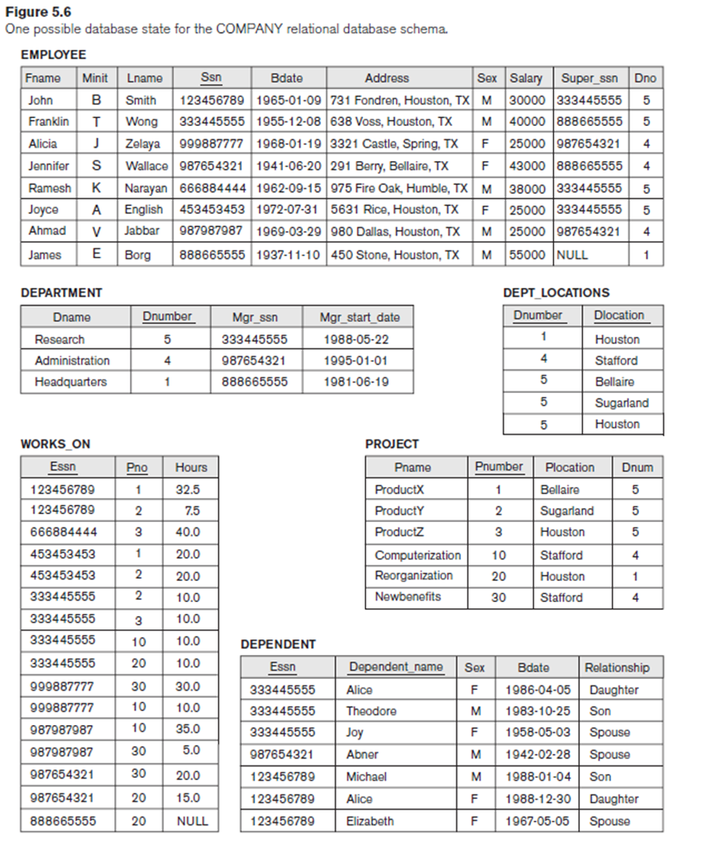
Query 25. For each project, retrieve the project number, the project name, and the number of employees who work on that project.
SELECT Pnumber, Pname, COUNT (*)
FROM PROJECT, WORKS_ON
WHERE Pnumber = Pno
GROUP BY Pnumber, Pname;
Notes:
Q25: SELECT Pnumber, Pname, COUNT (*)
FROM PROJECT, WORKS_ON
WHERE Pnumber = Pno
GROUP BY Pnumber, Pname;

Slide 48
HAVING clause
HAVING : Provides a condition to select or reject an entire group:
Only the groups that satisfy the condition are retrieved in the result of the query.

Slide 49
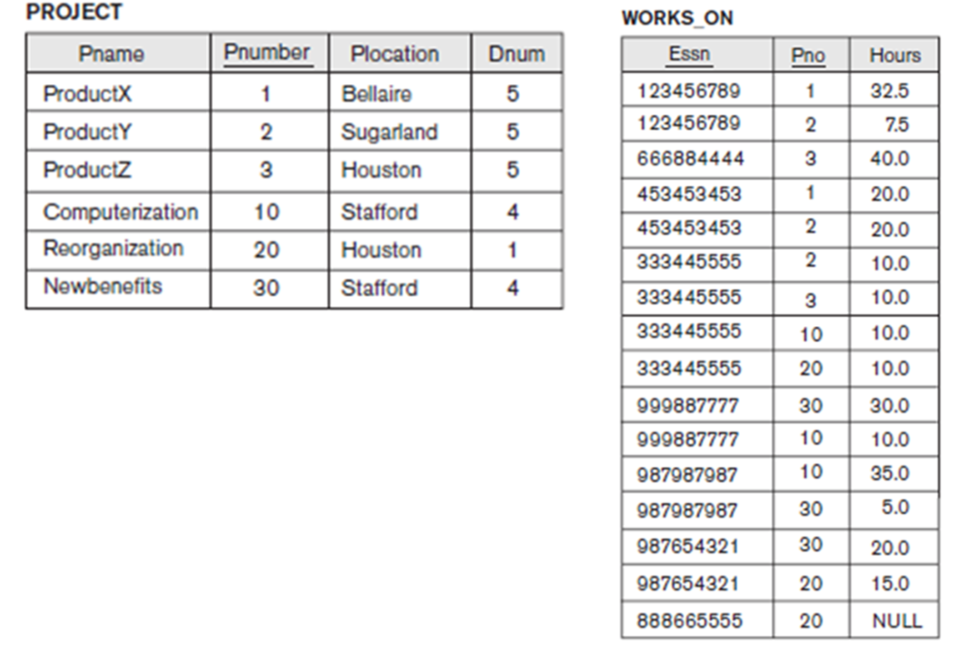
Query 26. For each project on which more than two employees work, retrieve the project number, the project name, and the number of employees who work on the project.
Q26: SELECT Pnumber, Pname, COUNT (*)
FROM PROJECT, WORKS_ON
WHERE Pnumber = Pno
GROUP BY Pnumber, Pname
HAVING COUNT (*) > 2;
Notes:
Q26: SELECT Pnumber, Pname, COUNT (*)
FROM PROJECT, WORKS_ON
WHERE Pnumber = Pno
GROUP BY Pnumber, Pname
HAVING COUNT (*) > 2;

Slide 50
Query 27. For each project, retrieve the project number, the project name, and the number of employees from department 5 who work on the project.
Q27: SELECT Pnumber, Pname, COUNT (*)
FROM PROJECT, WORKS_ON, EMPLOYEE
WHERE Pnumber = Pno AND Ssn = Essn AND Dno = 5
GROUP BY Pnumber, Pname;
Notes:
Q27: SELECT Pnumber, Pname, COUNT (*)
FROM PROJECT, WORKS_ON, EMPLOYEE
WHERE Pnumber = Pno AND Ssn = Essn AND Dno = 5
GROUP BY Pnumber, Pname;

Slide 51
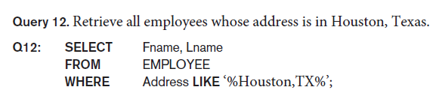
Substring Pattern Matching
LIKE comparison operator: string pattern matching
Partial strings are specified using two reserved characters:
% replaces an arbitrary number of zero or more characters
underscore (_) replaces a single character.
Examples:
Notes:
% wildcard characte

Slide 52
Substring Pattern Matching
Query 12A. Find all employees who were born during the 1950s.
Q12: SELECT Fname, Lname
FROM EMPLOYEE
WHERE Bdate LIKE ‘_ _ 5 _ _ _ _ _ _ _’;
Notes:
If an underscore or % is needed as a literal character in the string, the character should be preceded by an escape character, which is specified after the string using the keyword ESCAPE. For example, ‘AB\_CD\%EF’ ESCAPE ‘\’ represents the literal string ‘AB_CD%EF’ because \ is specified as the escape character. Any character not used in the string can be chosen as the escape character. Also, we need a rule to specify apostrophes or single quotation marks (‘ ’) if they are to be included in a string because they are used to begin and end strings. If an apostrophe (’) is needed, it is represented as two consecutive apostrophes (”) so that it will not be interpreted as ending the string. Notice that substring comparison implies that attribute values are not atomic (indivisible) values, as we had assumed in the formal relational model

Slide 53

SQL Arithmetic Operators
Operator | Description
+ | Add
- | Subtract
* | Multiply
/ | Divide
% | Modulo
Query 13. Show the resulting salaries if every employee working on the
‘ProductX’ project is given a 10% raise.
SELECT E.Fname, E.Lname, 1.1 * E.Salary AS Increased_sal
FROM EMPLOYEE E, WORKS_ON W, PROJECT P
WHERE E.Ssn = W.Essn AND W.Pno = P.Pnumber AND
P.Pname = ‘ProductX’;

Slide 54
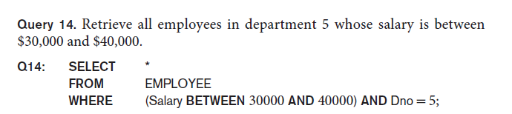
Comparison Operator: Between
BETWEEN: TRUE if the operand is within the range of comparisons
The condition (Salary BETWEEN 30000 AND 40000) in Q14 is equivalent to the condition ((Salary >= 30000) AND (Salary <= 40000)).

Slide 55
Some Other Examples
LIKE Operator | Description
LIKE 'a%' | Finds any values that start with "a"
LIKE '%a' | Finds any values that end with "a"
LIKE '%or%' | Finds any values that have "or" in any position
LIKE '_r%' | Finds any values that have "r" in the second position
LIKE 'a_%' | Finds any values that start with "a" and are at least 2 characters in length
LIKE 'a__%' | Finds any values that start with "a" and are at least 3 characters in length
LIKE 'a%o' | Finds any values that start with "a" and ends with "o"

